Slide 1

C++ Software Transactional Memory (STM)
Zoltan Fuzesi
Software Engineering
2017/2018
Supervisor : Joseph Kehoe

Slide 2

What is STM?
Concurrency control mechanism.
    Provide lock free programming.
Similar to database transactions - ACID.
    Atomicity: All changes are made (commit) or none (roll back)
    Consistency: Transaction always transform the state from one consistent state to another.
    Isolation: one transaction cannot read data from other transaction until not committed.
    Durability: STM store data only in memory.
Controlling access to shared memory.
Can be slow if too many times needs to restart the transactions.
Store object type or primitive type.
Dead lock, segmentation fault, starvation, too many ownership.

Slide 3
How does it work?
Register original object/shared memory
Load copy object/memory
Application
Store object changes
STM library
Commit changes/ make visible
tx->register(object_one);
tx->register(object_two);
while(!done)
{
object_one = tx->load(object_one);
object_one->set_value(object_one->get_value() + 10);
tx->store(object_one);
object_two = tx->load(object_two);
object_two->set_value(object_two->get_value() - 10);
tx->store(object_two);
done = tx->commit(object_one);
}
stm_init_thread();
START(0, RW);
int tmp = (int) stm_load(&src->value);
tmp = tmp - 10;
stm_store(&src->value, tmp);
tmp = (int) stm_load(&dst->value);
tmp = tmp + 10;
stm_store(&dst->value, tmp);
stm_commit();
// sigjmp_buf *_e = stm_get_env(); stm_tx_attr_t _a = //{id, ro}; sigsetjmp(*_e, 0);

Slide 4
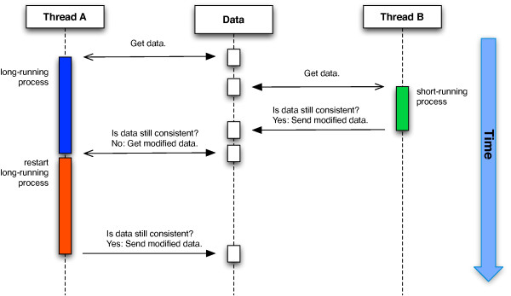
Starvation, version checking
https://www.researchgate.net/

Slide 5
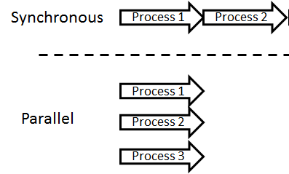
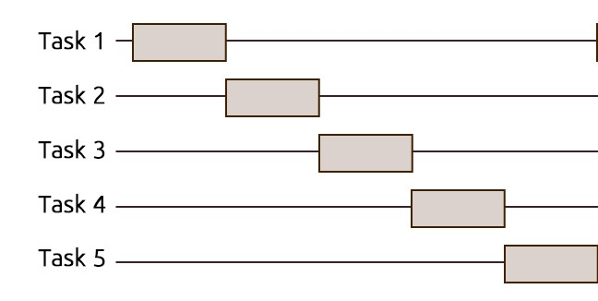
Why use STM over lock based software solution?
STM based threaded environment (parallel)
Lock based threaded environment (sequential)

Slide 6
Other C/C++ STM implementations
RSTM The University of Rochester STM written by a team of researchers led by Michael L. Scott.
TL2 STM from the Scalable Synchronization research group at Sun Microsystems Laboratories.
Intel STM Compiler Prototype Edition.
TinySTM by Patrick Marlier and Pascal Felber.
and few more…

Slide 7
Requirements
Mandatory. Library: Full STM implementation; Documentation: Full documentation of Library; Tutorial: A tutorial showing how to use the library;
Discretionary. Portability: Library is tested across multiple platforms (Windows, Linux and OSX); Web Site: The Library is backed up with a website demonstrating its usage.
Exceptional. Benchmarks: The library is fully benchmarked; Comparisons: Comparisons between STM and other approaches

Slide 8
What is ready? What else need to do?
When it is ready? Composition, nested transaction, priority?
Code refactoring. Hide some code from .h file.
Library implementation on Windows and Mac OS.
Documentation (Doxygen).
Website with tutorial of library usage.
Benchmarking . Compare with similar libraries???

Slide 9

Questions?

